Slide 1
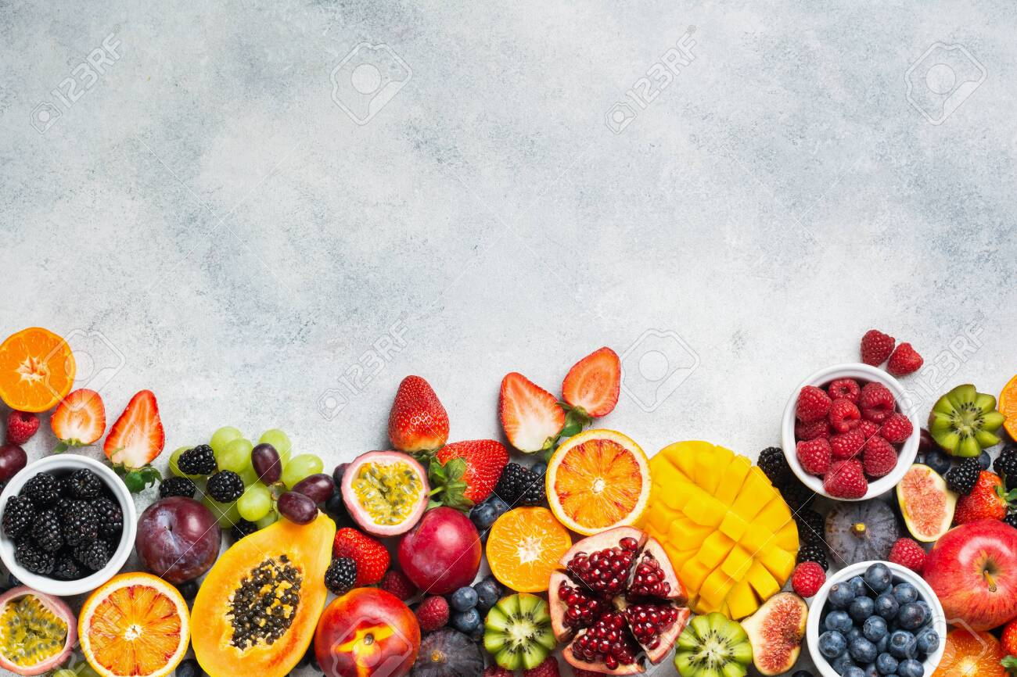
FRUIT IDENTIFICATION AND CLASSIFICATION
USING NEURAL NETWORKS

Slide 2
INTRODUCTION
Recognition system is an important field concerned with recognizing patterns, particularly visual and sound patterns. It is central to optical character recognition, voice recognition, and handwriting recognition.
Similarly as above cases fruit recognition and classification can be done. The food industry has widely used machine vision for quality inspection of fruits, vegetable and processed food.
There the first step is to recognize and classify fruits. The features are then extracted using a pretrained CNN model resulting in a feature vector which identifies a fruit, based on color, shape, texture and intensity based features

Slide 3
IMPLEMENTATION
INPUT
Build ML model for fruit detection
Develop a Flask Server
Web Browser
Response
OUTPUT

Slide 4
STEPS
Step 1: Build a ML model for fruit classification based on features extracted using RESNET 18 pretrained convolution neural network
Step 2: Save the model as a file.
Pytorch model: model.pt
Step 3: Build a flask app
To read inputs from user
To return outputs to the user

Slide 5
STEPS
.
Step 4:Embed the ML model and build an inference pipeline for your model.
Input from the user torch.transforms torch model output
Step 5: Observe the predicted output for the test input image in the web browser.

Slide 6
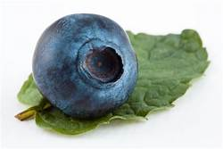
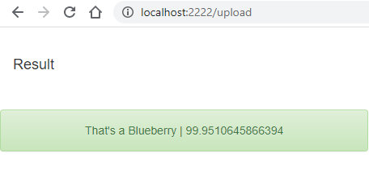
RESULT

Slide 7

Thank you!

